Slide 1


Geographic Biases in OSM Contributions: How do the Geographic Extent of Contributions Differ among Demographic groups?
Hyesop Shin, Ana Basiri
05.04.2022
Full paper in the revision process with AAG

Slide 2






Volunteered
Geographic
Information
the use of digital devices to collect, assemble, modify and share geographic data provided voluntarily by citizens
(Goodchild, 2007)
Notes:
Volunteered
Geographic
Information

Slide 3



Our Focus: the Volunteers
Our focus
Most VGI studies focus on Data quality

Slide 4
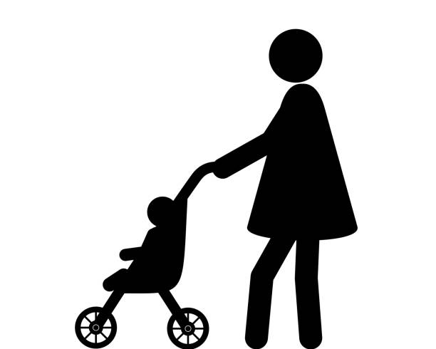



Volunteers are not always representative
Under-represented crowd
A silent minority who needs information about public facilities
A community with local knowledge but weakness in internet technology
Voluntary works are to some extent associated with the time spent on computers and social media (Jago et al., 2014; Clary et al., 2020)

Slide 5

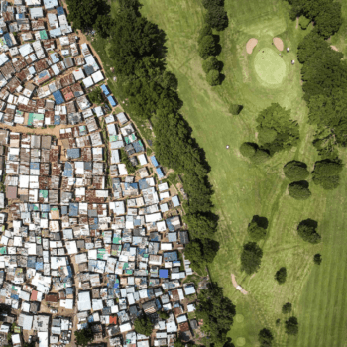
Under-representation and Spatial Bias
Patchy distribution of maps across space and time
A well-known feature of the data from citizen science projects is the patchy distribution of maps across space and time
This leaves global citizen science datasets with spatial and temporal gaps and redundancies
The majority tend to contribute to more familiar areas
The minority spend less time on volunteered works, tend to contribute to neighbourhood areas

Slide 6
VGI Contributors’ Bias: Why should we care?
If we collapse the information, we might not be able to give essential information:
To get a full picture of the reality for intervening politic issues (e.g. bike safety)
To limit further intervention of building more inclusive platforms
As daily volunteering routines and preferences can reveal habits and interests which affect their future contributed contents (Basiri et al., 2019).
Notes:
Volunteers’ Daily Routine
As daily volunteering routines and preferences can reveal habits and interests which affect their future contributed contents (Basiri et al., 2019).

Slide 7
Research Gaps
Current literature of citizen science looking at spatial and temporal biases:
Ecological Fallacy
Do not breakdown the records by demographic groups even though certain cohorts have different distributions than their counterparts. These studies only imply gender or age biases as a whole.
Focus either on demographic characteristics or spatial and temporal patterns - the two perspectives are usually not put into relation with each other
Strava is attempting to consider gender, age
Still very young stage
There is a need to jointly consider the participants’ demographic characteristics as well as how their volunteering patterns differ over time and space
Notes:
https://findingspress.org/article/33280-changes-in-the-representativeness-of-strava-bicycling-data-during-covid-19

Slide 8
Study Objective
To explore the number of contributed countries to OSM between gender and age
To quantify the diversity of OSM contributions between gender and age

Slide 9
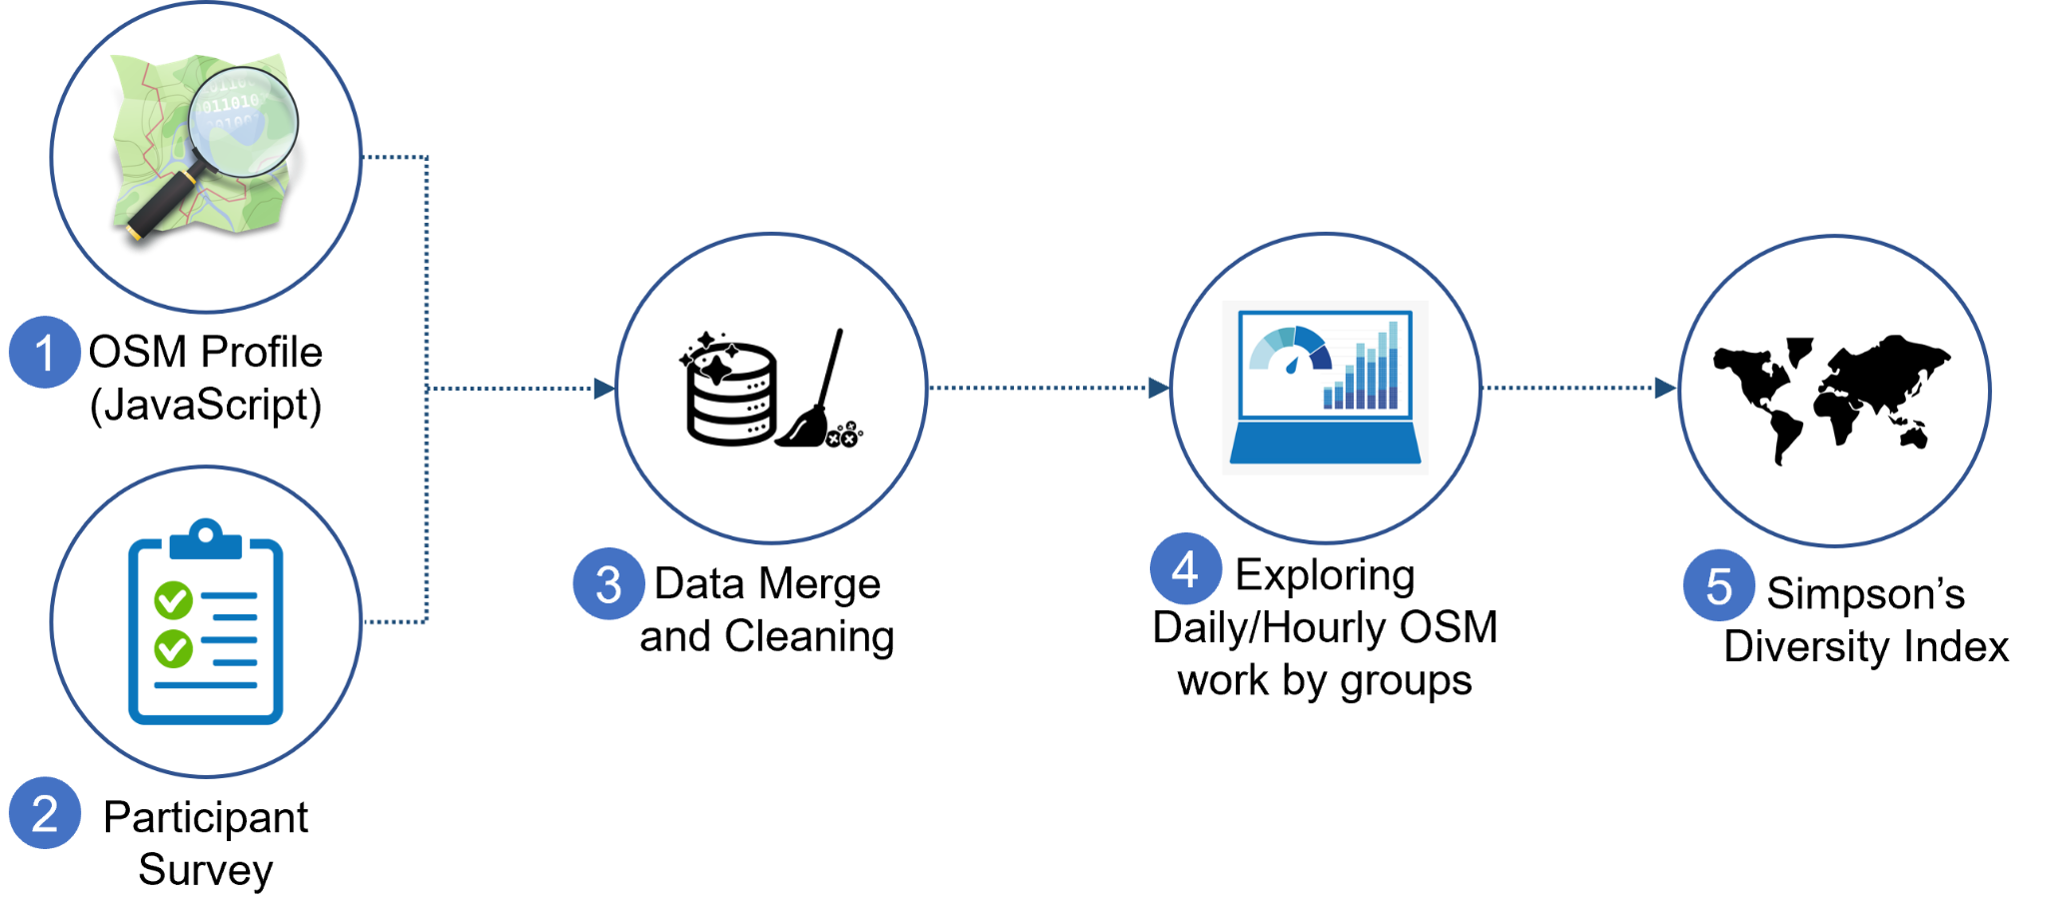


Methods
ID, Gender, Age, Nationality
218 respondents
30 women (14%)
188 men (86%)
Non-binary was included in the survey but excluded due to not meeting the requirement bar

Slide 10
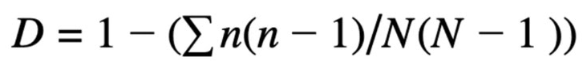
Gini-Simpson’s Diversity Index: The Metrics
N: the number of contributions for the total countries contributed
n: the number of contributions for a single country
We analyzed user’s mapping behaviour
We first defined at individual level and then aggregated by averaging over users with same gender and age cohort
Each individual will have a value between 0-1
0: Less diverse (tends to be domestic)
1: More diverse
Notes:
N: the total number of observations
ni: the number in the ith group

Slide 11
Results
Exploratory Findings
Simpson’s Diversity Index

Slide 12
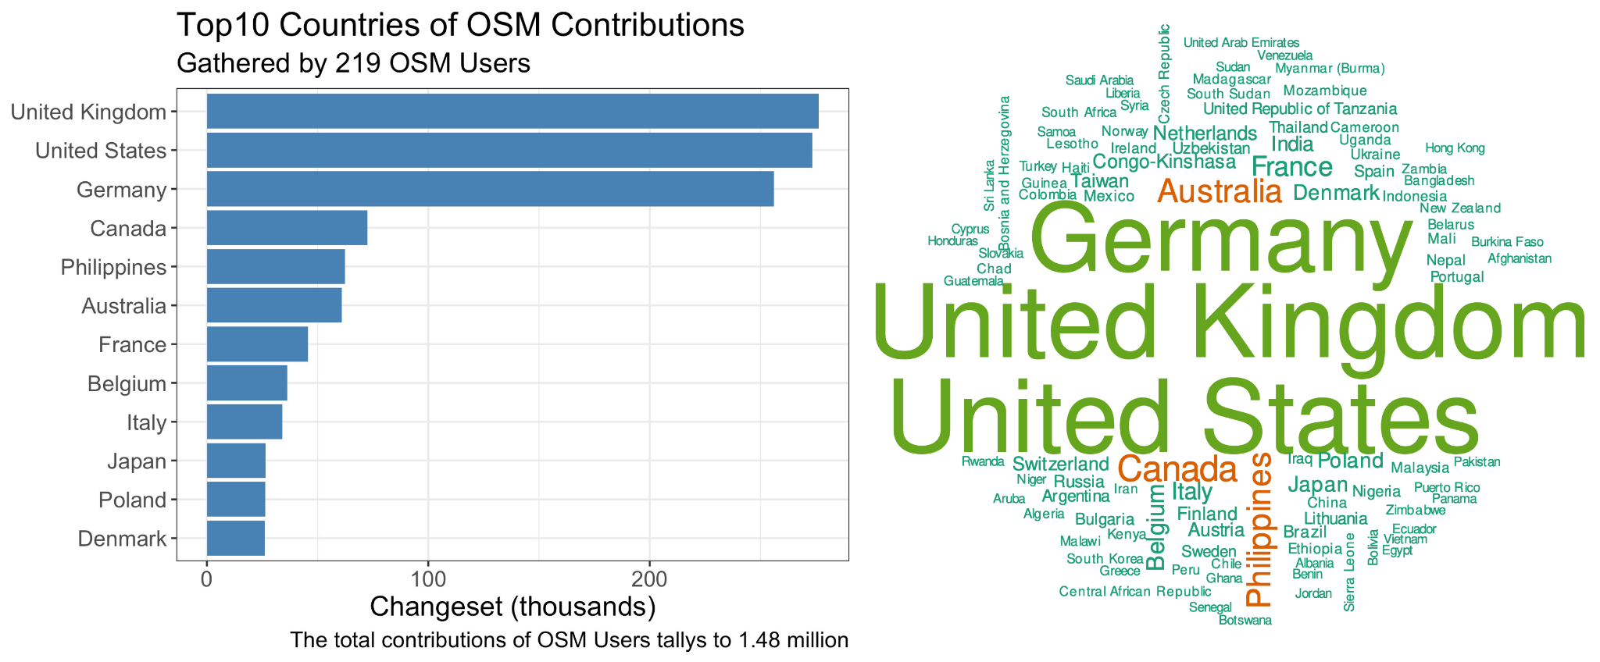
Top three countries accounted for 60% of the total contribution

Slide 13
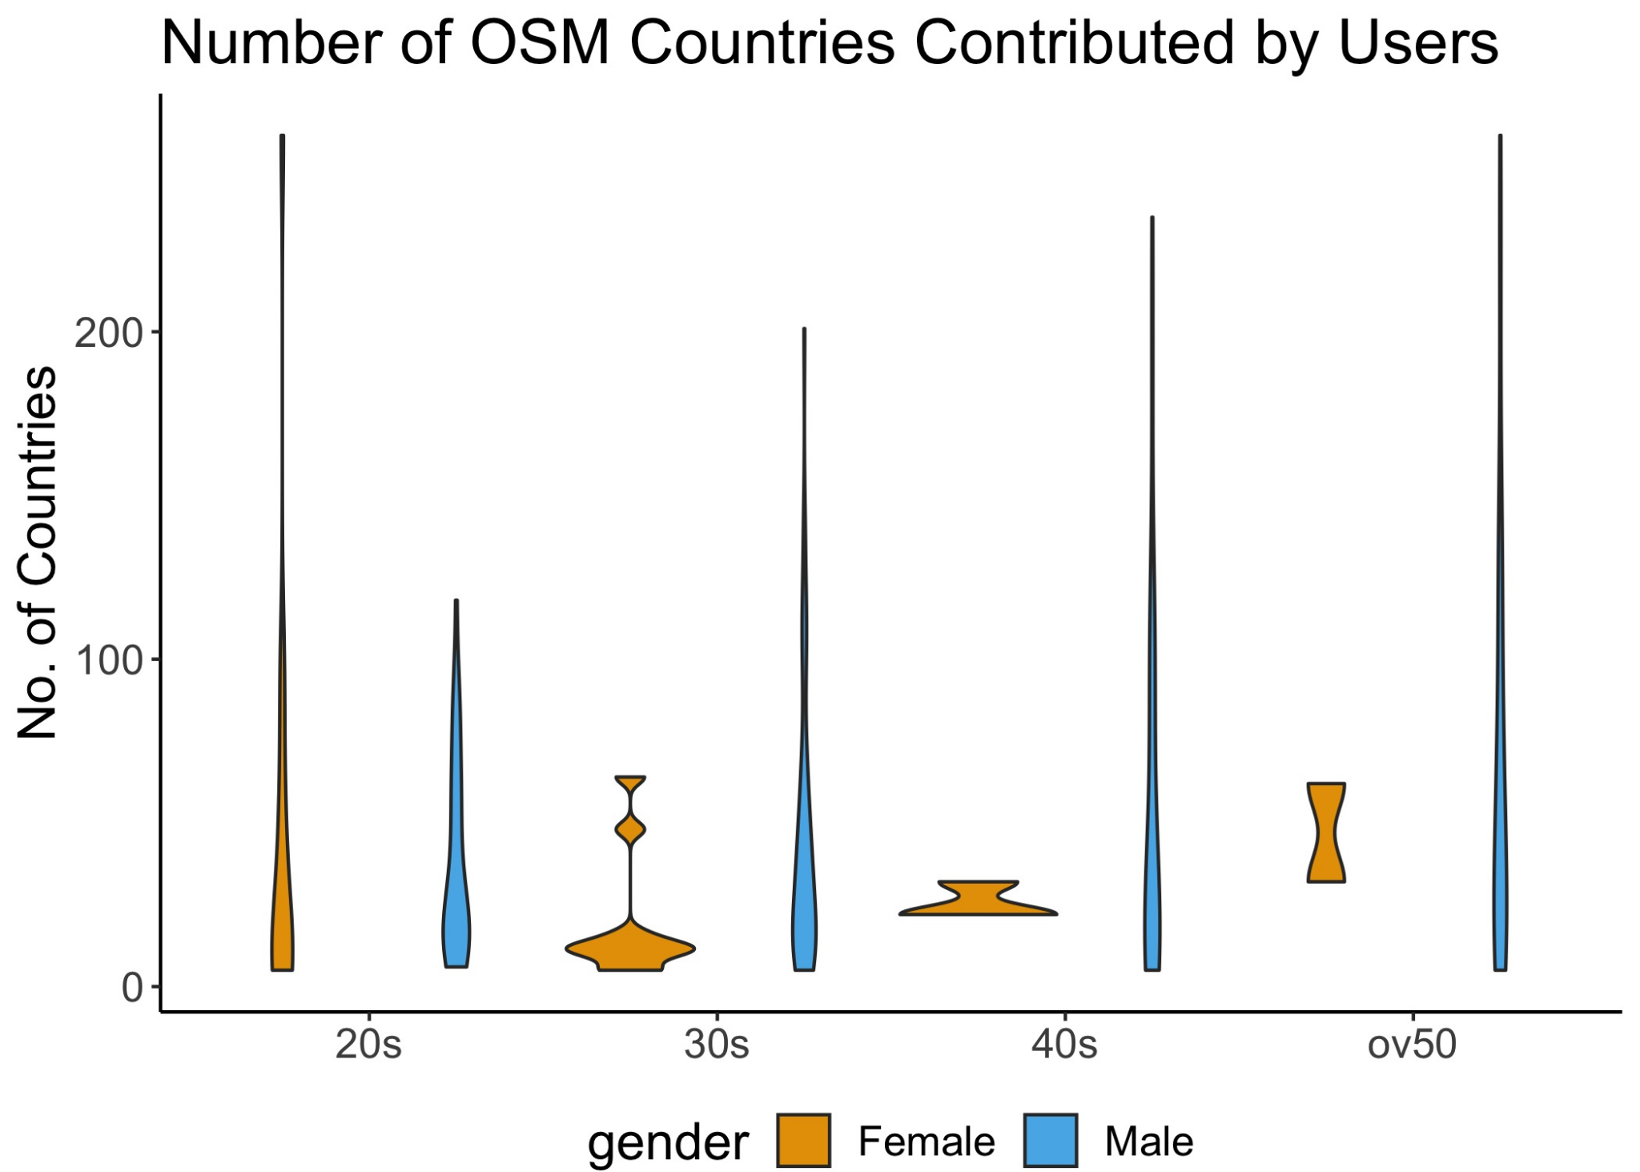
Contributed Countries by Users’ Demography
Long-tail distribution was seen in men and women in 20s
Women in 30s and over had fewer than 100 contributed countries
Likely due to fewer survey participants, but OSM, in general, might have a similar distribution

Slide 14
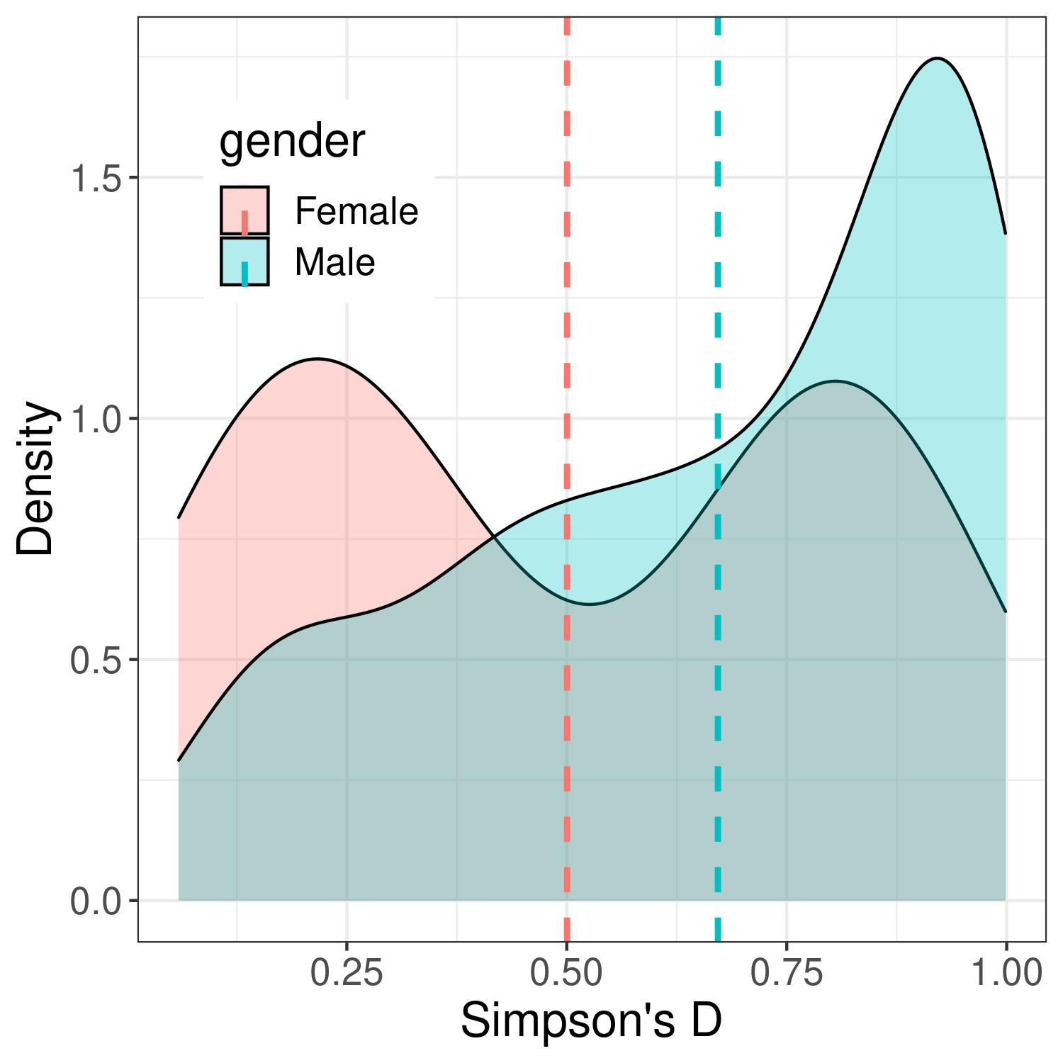
Results: Gini-Simpson’s Diversity Index
Average of GSDI: Female: 0.5 Male: 0.67
Male participants were likely contribute to more countries and wide distribution than their female counterparts.
However, two peaks of diversity patterns of the female users mean that the spatial preference within the group contrasts significantly
Density distribution of Simpson’s D by gender
Notes:
To measure biases in spatial preferences between contributor groups, the gendered average of the Gini-Simpson Index (GSI) was 0.5 for the female users and 0.67 for the male users (see Figure~\ref{fig:density}).
This means that male participants had more variability in regard to contributing to more countries and wide distribution than their female counterparts.
However, two peaks of diversity patterns of the female users mean that the spatial preference within the group contrasts significantly. Meanwhile, male participants show a right-skewed distribution, implying that more men tend to create/edit more international areas.

Slide 15
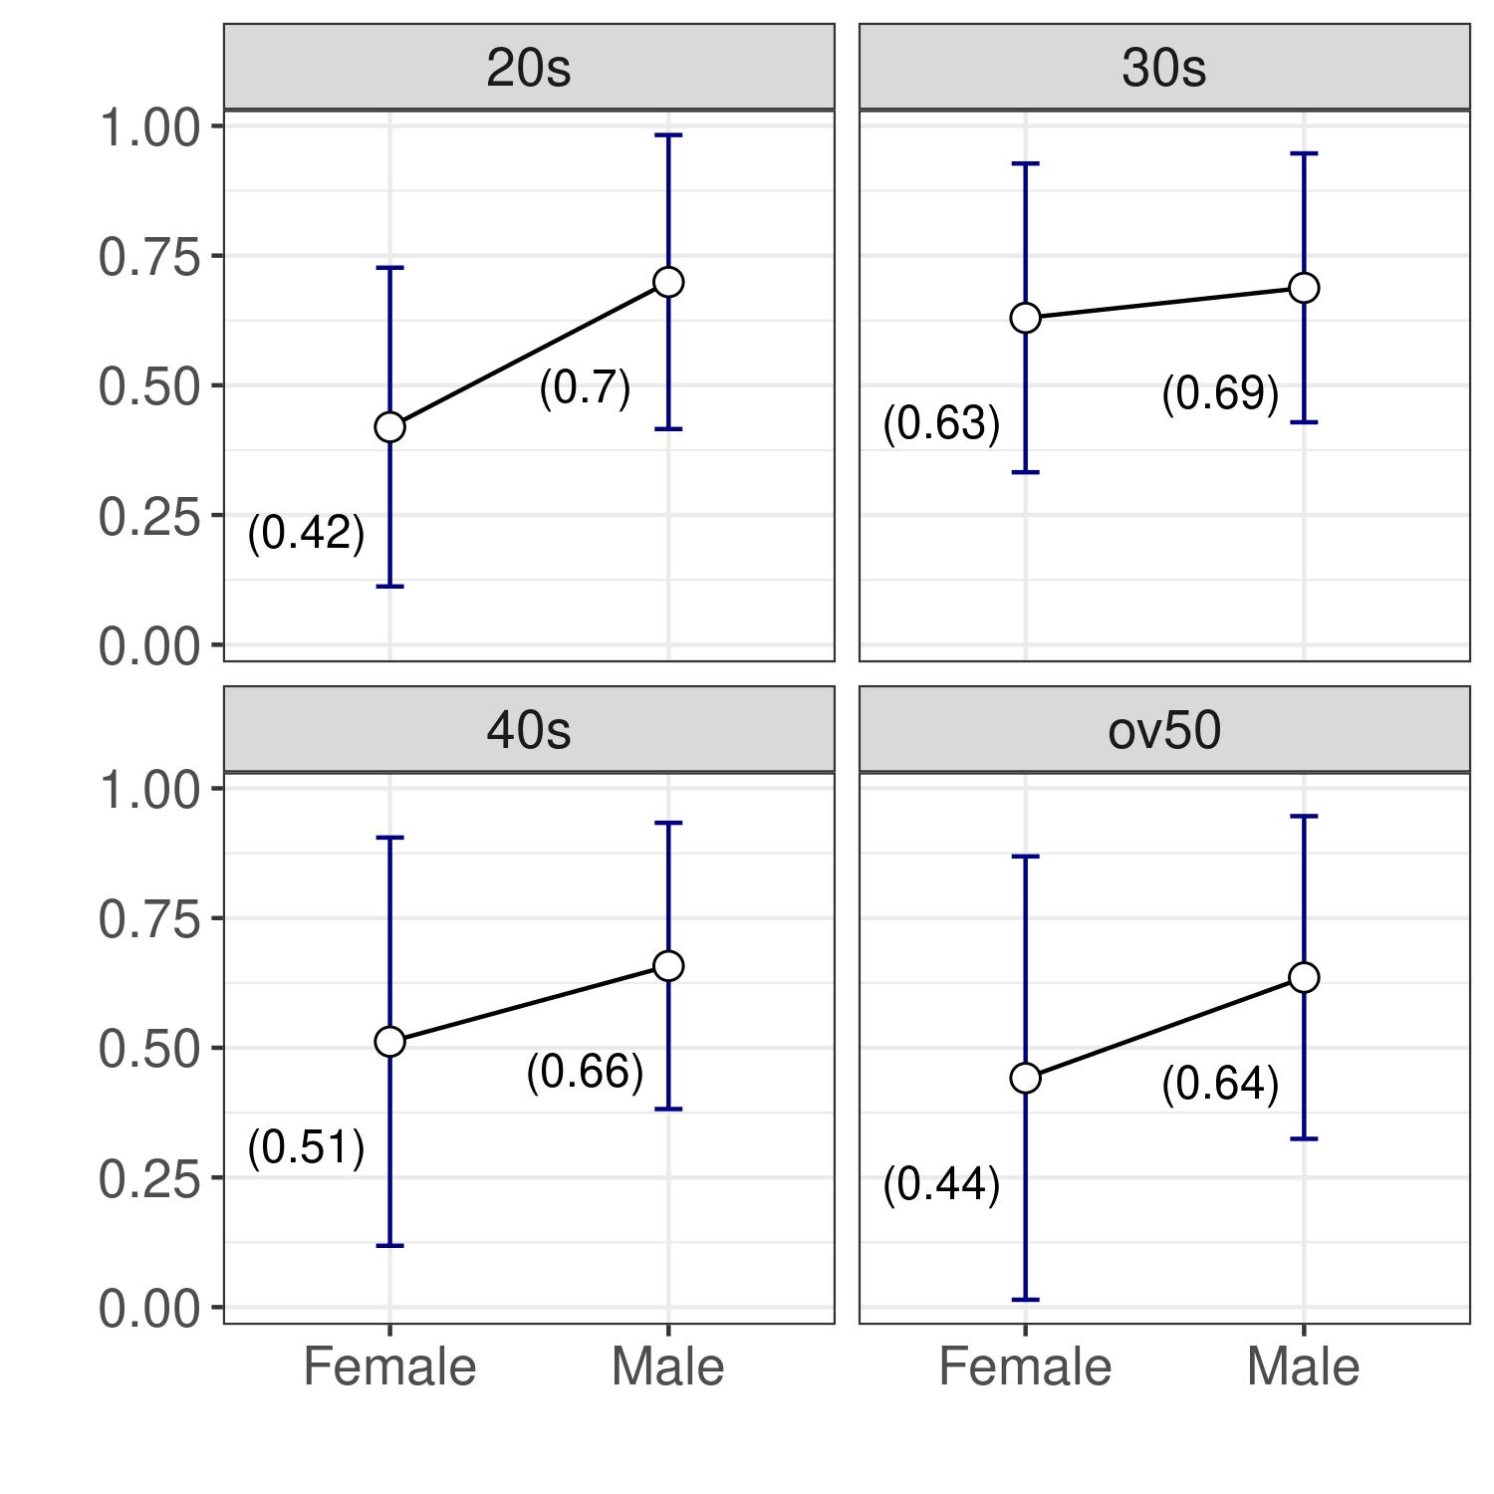
Results: Gini-Simpson’s Diversity Index
Male participants have systematically scored higher diversity measures across both age groups, and the average scores are less likely to differ between age groups
The scores from female participants are constantly lower than that of males, and it varies significantly by age group
Female 40-50s’ have wider variation due to small number of participants

Slide 16
Conclusion
Main Contribution: Exploratory Analysis
Women’s spatial coverage to OSM were remarkably lower than that of men
However, such variabilities can be identified by the disaggregation of gender and age
Men in 20s' to over 50s' groups and women in the 20s' group had polarised contributions where the averages were at 40-50 countries but have extreme users who contribute to over 150 countries.
60% of the participants made changes to the UK, the US, and Germany.
Main Contribution: Gini-Simpson’s Diversity Index
Men: 0.67 Women 0.50
Men were more likely to be spatial diverse than their female counterparts. However, this once again varied significantly by the age groups.
Notes:
We employed the number of countries and changesets contributed by users as proxies to estimate the individual has a propensity to contribute locally or internationally.
Men in 20s' to over 50s' groups and women in the 20s' group had polarised contributions where the averages were at 40-50 countries but have extreme users who contribute to over 150 countries. Also, nearly 60% of the participants made changes to the UK, the US, and Germany.

Slide 17
Conclusion
Things we noticed
Unequal samples: Men (188 persons) vs Women (30 persons) ⇐ might represent the online population?
The nature of crowdsourcing: a few extreme users can change the entire statistics “long-tail”
Conversion of time zones: OSM only provides the hours by UTC, resulting in inaccurate timezones for countries with multiple timezones (e.g. USA, Russia, Brazil)
Future Studies
The authors can send another information survey to inform their local timezone
Examine more representative and gender-age sampling to identify any biases given a similar number of respondents.
We want to build an inclusive platform!

Slide 18
Thank You

